Slide 1
Topic: HR Analytics
BY:
Seema Hullati

Slide 2
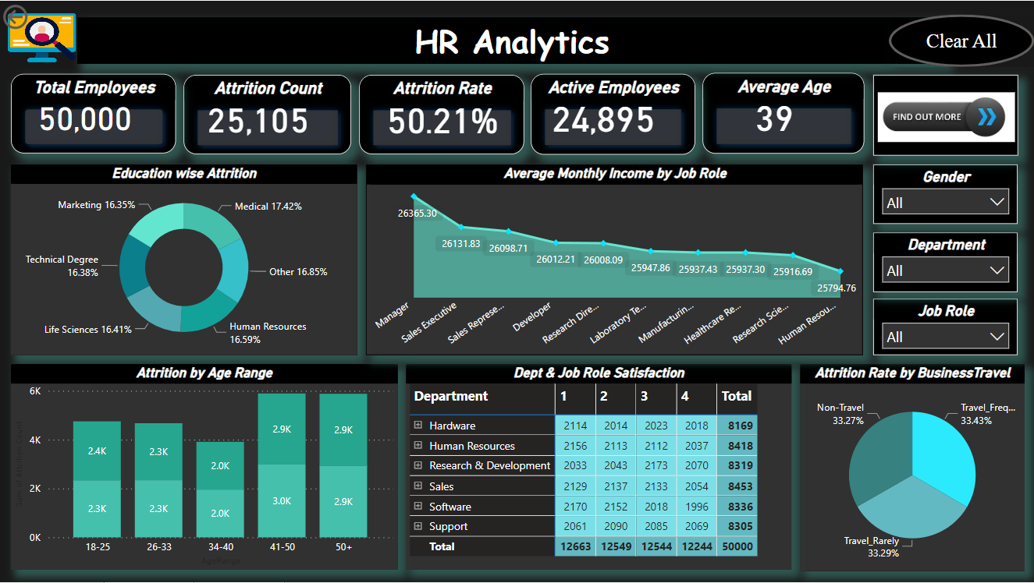
Dashboard

Slide 3
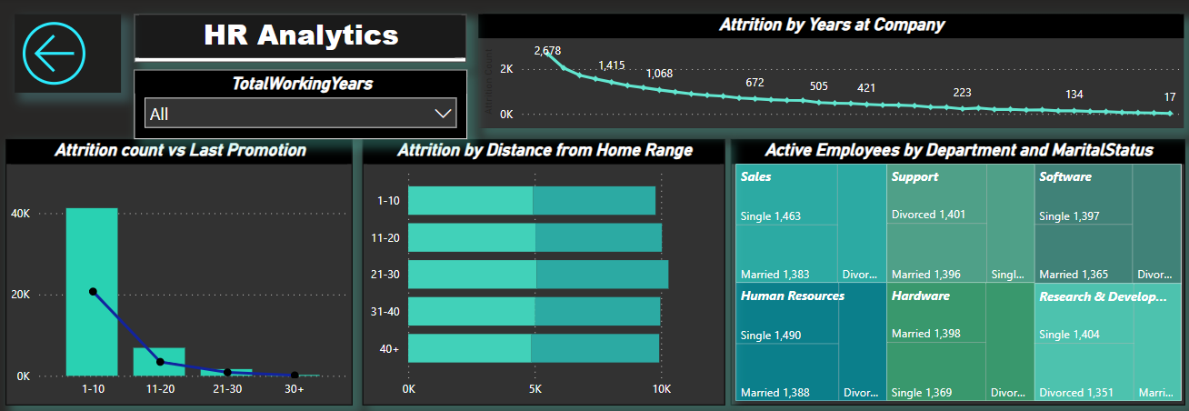
DASHBOARD

Slide 4
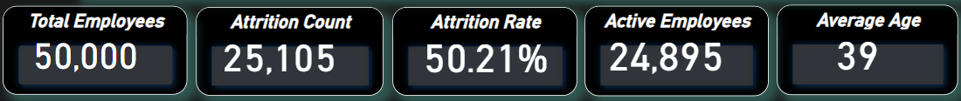
KPIs
Self Explanatory

Slide 5
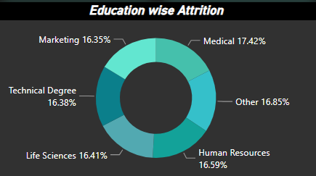
KPIs
As we can see in the above chart, the highest attrition is coming from Medical education field, and the lowest is coming from Marketing field.

Slide 6
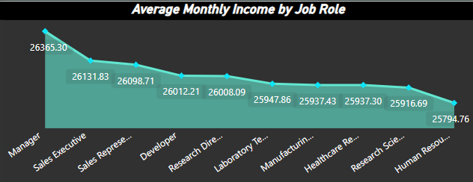
KPIs
Here we can notice that on an average, employees from every Job Role makes almost 26,000 monthly.
The highest average income is from Manager role and the lowest average is from HR role.

Slide 7
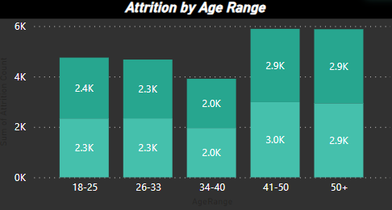
KPIs
From here we can derive that the age group 41-50 has the highest attrition count while the age group 34-40 has the lowest attrition count.

Slide 8
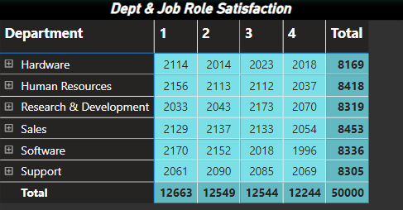
KPIs
As the above table displays, the highest no. of employees as per job satisfaction rating are under rating “1” and lowest no. of employees comes under rating “4”.
Same way we can determine department wise and job role wise separately.

Slide 9
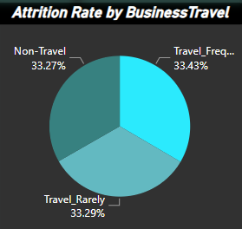
KPIs
The attrition rate is slightly higher among employees that travel frequently compared to those that travel rarely or don’t travel at all.

Slide 10
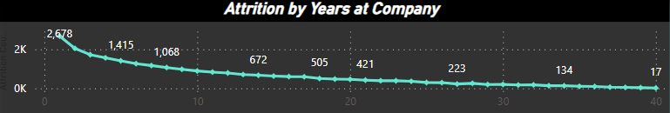
KPIs
The attrition count is the highest for employees that have worked at company only for one year.
The attrition count gradually decreases overtime as seen in the chart above.

Slide 11
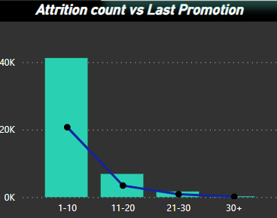
KPIs
For the year group “1-10” the attrition count is highest, it denotes the period since last promotion for the employees.
It decreases overtime too.

Slide 12
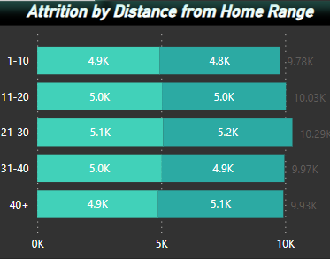
KPIs
As seen in the chart, the highest attrition comes from distance group “21-30”.
The different colors are nothing but the number of males and females among the attrition count.

Slide 13
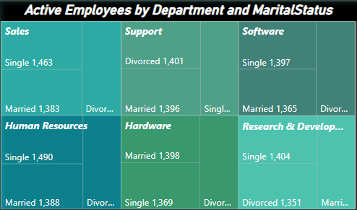
KPIs
We can see the number of active employees at the company in the chart above.
The Sales dep has the highest number of active employees among all the other departments, which are further categorised according to their marital status.

Slide 14
SuggestionS
As we noticed the attrition from Medical field is the highest, the organization can pay attention towards why it is happening and make necessary changes required. Not only towards a specific field but about all the fields as well.
Should work towards the reasons for the attrition, whether it was due to slow career growth or poor work life balance. It can be done by running training programs for employees where they can learn the skills required for growth and continue working, and introducing flexible schedule for them which won’t require them to work after working hours without their consent/will.
Introducing new bonds for freshers with compulsion to work minimum of two years which will help bring down the attrition count for the employees working for one year in the organization. It will also keep job hoppers at bay.
Conducting anonymous surveys to get honest feedback from the employees about their experience from time to time.

Slide 15
Thank You

